Slide 1
K medoids also called Partitioning Around Medoids
Clustering algorithm
Notes:
Convert all symbols to pictures, especially equation objects

Slide 2
K-means is sensitive to initial seed value (K value).
The k-means algorithm is sensitive to outliers because an object with an “ extremely large value” may substantially distort the distribution.
The k-Mediods algorithm aims to diminish the effect of outliers.
This algorithm was proposed in 1987 by Kaufman and Rousseeuw.
Also known as partitioning around medoids (PAM).
The basic idea of K-mediods, is that one of the data object acts as cluster center (one representative object per cluster) instead of taking the mean value of the objects in a cluster (as in k-Means algorithm)
We call this cluster representatives as a cluster medoid or simply medoid.

Slide 3
K-Medoids is a clustering algorithm resembling the K-Means clustering technique.
It falls under the category of unsupervised machine learning. It majorly differs from the K-Means algorithm in terms of the way it selects the clusters’ centres. The former selects the average of a cluster’s points as its centre (which may or may not be one of the data points) while the latter always picks the actual data points from the clusters as their centres (also known as ‘exemplars’ or ‘medoids’).
K-Medoids also differs in this respect from the K-Medians algorithm which is the same as K-means, except that it chooses the medians (instead of means) of the clusters as centres.

Slide 4


K-Medoids
Partition based clustering (K partitions)
Effective, why ?
  Resistant to outliers
  Do not depend on order in which data points are examined.
  Cluster center is part of dataset, unlike k-means where cluster center is gravity based.
K-medoids
K-means
Notes:
Results in convex shaped clusters
Looks like a voronoi diagram of representative objects

Slide 5
PAM (Partitioning Around Medoids)
[Goal]: Find K representative objects of the data set. Each of the K objects is called a Medoid, the most centrally located object within a cluster.
Notes:
Designed by Kaufmann and Rousseeuw

Slide 6
K medoid basic idea
One of the data points acts as cluster center (One representative object per cluster) instead of taking the mean value of the objects in a cluster as in k means clustering.
We call this cluster representative as cluster medoid or simply medoid.

Slide 7
medoid
Mean

Slide 8
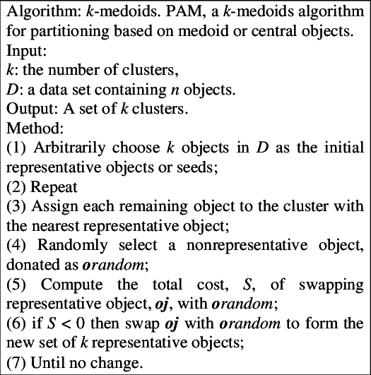

Slide 9
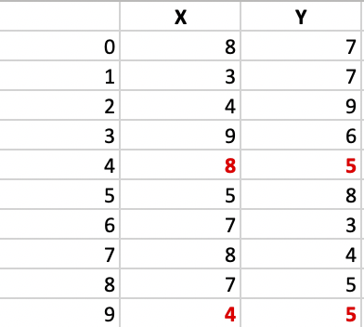
Let’s consider the following example:
Suppose K=2
C2
C1

Slide 10
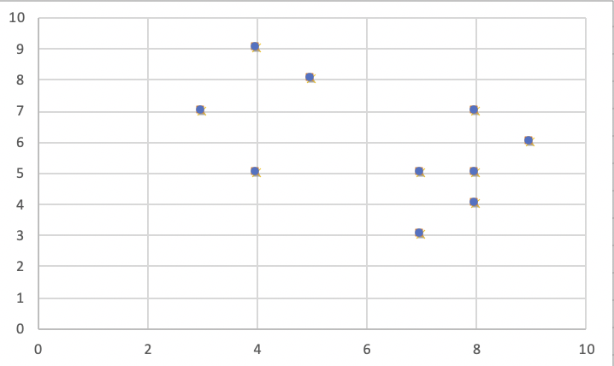

Slide 11
Step 1:
Assume k=2. Let the randomly selected 2 medoids, so select k = 2 and let C1 -(4, 5) and C2 -(8, 5) are the two medoids.

Slide 12
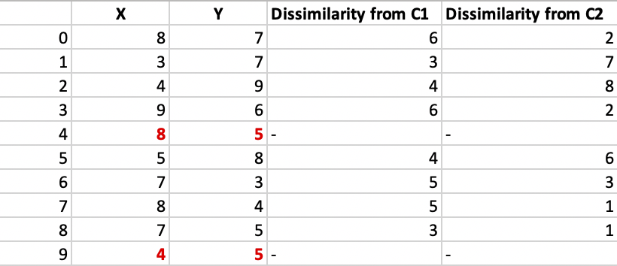

Step 2: Calculating cost.
The dissimilarity of each non-medoid point with the medoids C1 -(4, 5) and C2 -(8, 5) is calculated and tabulated:
C2
C1
C1
C2
C1
C2
C2
C2
Use Manhattan distance to calculate the dissimilarity
|8-4|+|7-5|=4+2=6
Notes:
(8

Slide 13
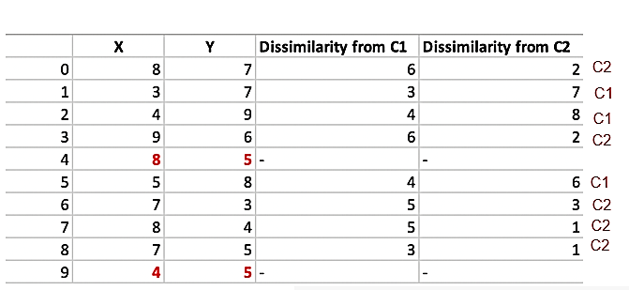
Each point is assigned to the cluster of that medoid whose dissimilarity is less.
The points 1, 2, 5 go to cluster C1 and 0, 3, 6, 7, 8 go to cluster C2.
Cost is the sum of distance of each non selected point from the selected point which is medoid of the cluster it belongs to.
The total Cost = (3 + 4 + 4) + (2 + 2 + 3 + 1 + 1) = 20

Slide 14
Step 3: randomly select one non-medoid point and recalculate the cost.
Let the randomly selected point be (8, 4).
The dissimilarity of each non-medoid point with the medoids – C1 (4, 5) and C2 (8, 4)

Slide 15
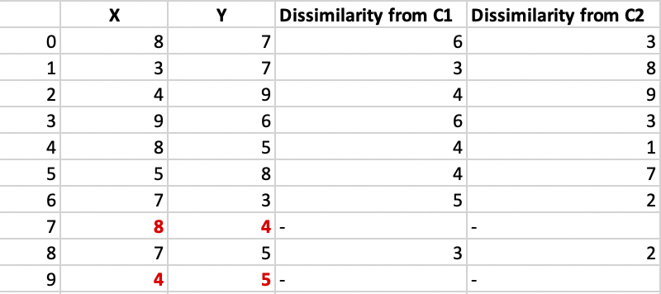
Calculate the distance of data points from C1 (4, 5) and C2 (8, 4)
C2
C1
C1
C2
C2
C1
C2
C2
Use Manhattan distance to calculate the dissimilarity
|8-4|+|7-5|=4+2=6

Slide 16
Each point is assigned to that cluster whose dissimilarity is less. So, the points 1, 2, 5 go to cluster C1 and 0, 3, 6, 7, 8 go to cluster C2.
The New total cost = (3 + 4 + 4) + (2 + 2 + 1 + 3 + 3) = 22
Swap Cost = New Cost – Previous Cost = 22 – 20 and 2 >0
As the swap cost is not less than zero, we undo the swap. Hence C1 -(4, 5) and C2 -(8, 5) are the two final medoids.
If New Cost – Previous Cost <0 then again do the iteration to check if the cost can be further decreased, so you can take one new data point and one old medoid from last iteration and find the cost.

Slide 17
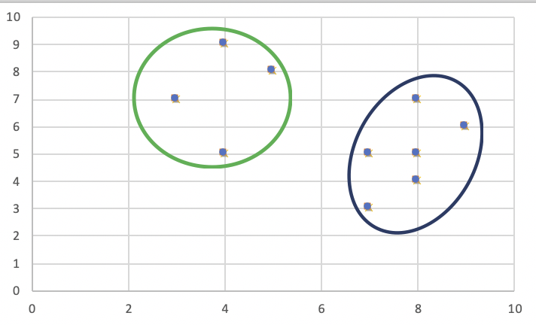
Final Clusters

Slide 18
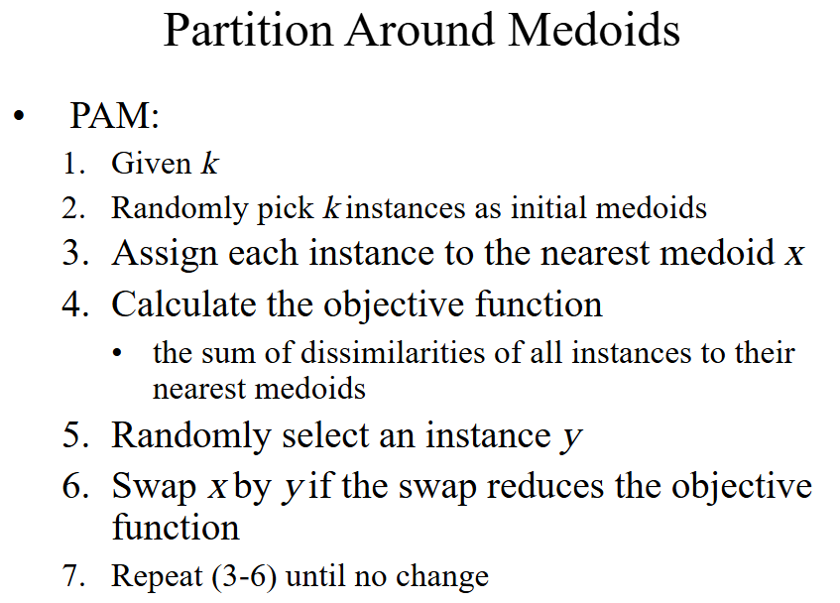

Slide 19
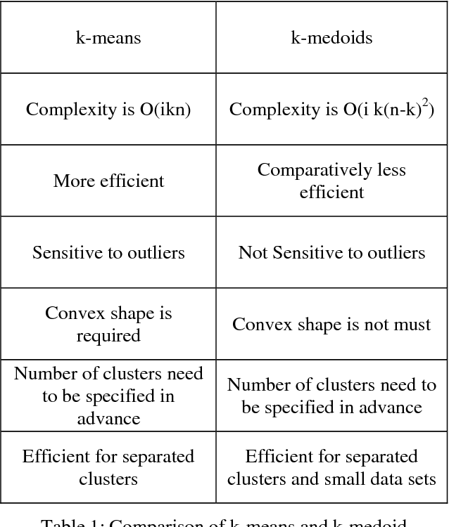
Differences between k-means and k medoids

Slide 20
Mean of the data points is a measure that gets highly affected by the extreme points. So in K-Means algorithm, the centroid may get shifted to a wrong position and hence result in incorrect clustering if the data has outliers because then other points will move away from . On the contrary, a medoid in the K-Medoids algorithm is the most central element of the cluster, such that its distance from other points is minimum. Since medoids do not get influenced by extremities, the K-Medoids algorithm is more robust to outliers and noise than K-Means algorithm

Slide 21
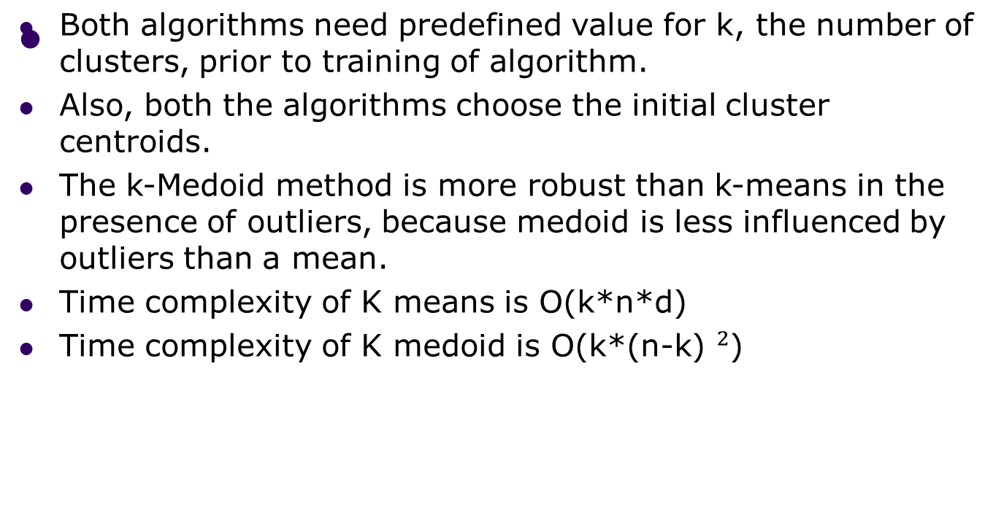
K-means vs k-medoids
K is the set of medoids, n is number of data samples, D is the dimensionality of data object

Slide 22
Limitation of k medoid
K-medoid does not scale well to large datasets because of its computationally complexity.
So there are some variants of K medoids for large datasets eg. CLARA, CLARANS etc.

Slide 23
Application of k medoid
K-Medoids algorithm is found useful for practical applications such as face recognition. The medoid can correspond to the typical photo of the individual whose face is to be recognized. But if K-Means algorithm is used instead, some blurred image may get assigned as the centroid, which has mixed features from several photos of the individual and hence makes the face recognition task difficult.

Slide 24
Choice of number of medoids
Randomly choose ‘k’ points from the input data (‘k’ is the number of clusters to be formed). The correctness of the choice of k’s value can be assessed using methods such as silhouette method. Silhouette score to check the optimal number of clusters.

Slide 25
Silhouette Coefficient or silhouette score is a metric used to calculate the goodness of a clustering technique. Its value ranges from -1 to 1.
1: Means clusters are well apart from each other and clearly distinguished.
0: Means clusters are indifferent, or we can say that the distance between clusters is not significant.
-1: Means clusters are assigned in the wrong way.

Slide 26
Silhouette Score = (b-a)/max(a,b)
where
a= average intra-cluster distance i.e the average distance between each point within a cluster.
b= average inter-cluster distance i.e the average distance between all clusters.

